Slide 1


Slide 2
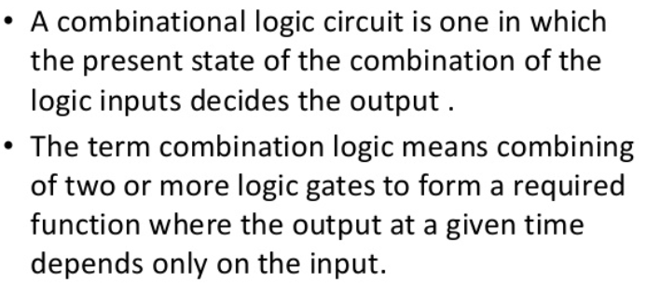

Slide 3
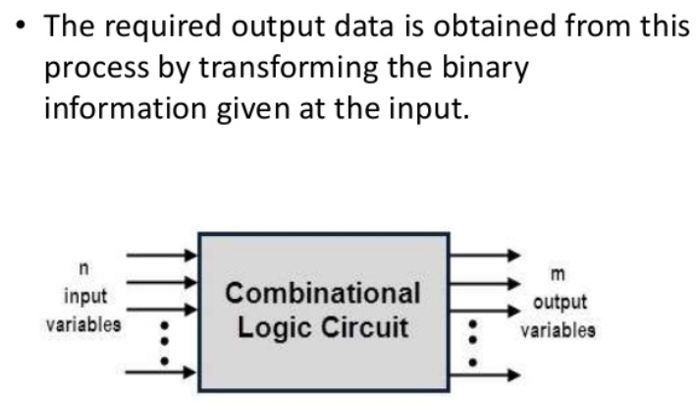

Slide 4
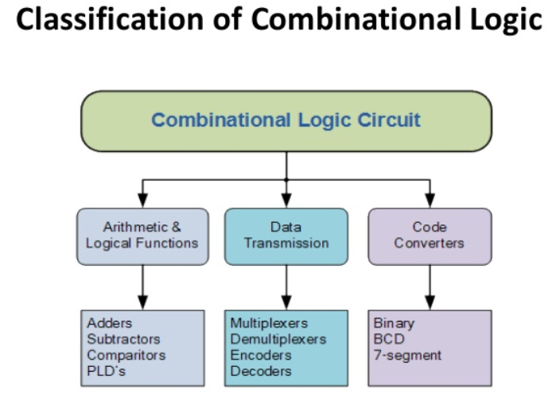

Slide 5
MULTIPLEXER

Slide 6
Multiplexer:
It is a combinational logic circuit.
It is a device that selects between several analog or digital input signals and forwards it to a single output line.
Input – 2^{n}
Output – 1
Multiplexer – 2^{n} : 1
The selection of particular input line is controlled by a set of selection lines.
It is also called Data Selector.
There is a Enable input, which is required to connect two or three multiplexer in parallel.
2^{n}
Input Lines
MUX
1
Output Line
Enable Input
n
Selected Lines

Slide 7


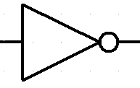



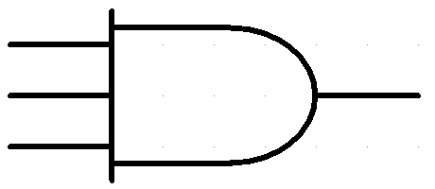



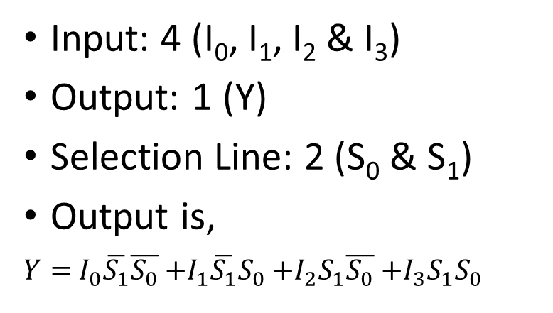
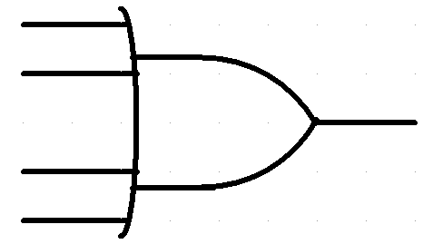










Design of 4:1 Mux:
S₁ | S₀ | Y
0 | 0 | I₀
0 | 1 | I₁
1 | 0 | I₂
1 | 1 | I₃
4:1 MUX

Slide 8





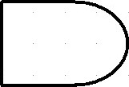







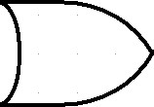

















Design of 8:1 Mux:
S₂ | S₁ | S₀ | Y
0 | 0 | 0 | I₀
0 | 0 | 1 | I₁
0 | 1 | 0 | I₂
0 | 1 | 1 | I₃
1 | 0 | 0 | I₄
1 | 0 | 1 | I₅
1 | 1 | 0 | I₆
1 | 1 | 1 | I₇
Input: 8 (I₀, I₁, I₂, I₃, I₄, I₅, I₆, I₇ & I₈)
Output: 1 (Y)
Selection Line: 3 (S₀, S₁ & S₂)
Output is,
8:1 MUX

Slide 9



















Design of 16:1 MUX using 8:1 MUX
8:1 MUX
S₃ | S₂ | S₁ | S₀ | Y
0 | 0 | 0 | 0
0 | 0 | 0 | 1
0 | 0 | 1 | 0
0 | 0 | 1 | 1
0 | 1 | 0 | 0
0 | 1 | 0 | 1
0 | 1 | 1 | 0
0 | 1 | 1 | 1
0 | 0 | 0 | 0
0 | 0 | 0 | 1
0 | 0 | 1 | 0
0 | 0 | 1 | 1
0 | 1 | 0 | 0
0 | 1 | 0 | 1
0 | 1 | 1 | 0
0 | 1 | 1 | 1
A
B
C
D
B
Y
C
D
8:1 MUX
B
C
D

Slide 10
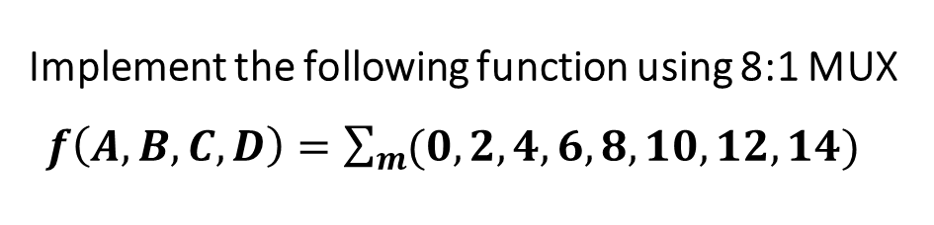
















8:1 MUX
 | 0 | 1 | 2 | 3 | 4 | 5 | 6 | 7
 | 8 | 9 | 10 | 11 | 12 | 13 | 14 | 15
 | 1 | 0 | 1 | 0 | 1 | 0 | 1 | 0

Slide 11
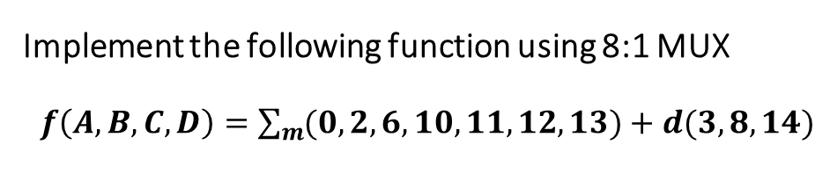





8:1 MUX
 | 0 | 1 | 2 | 3 | 4 | 5 | 6 | 7
 | 8 | 9 | 10 | 11 | 12 | 13 | 14 | 15
 | 1 | 0 | 1 | 1 | A | A | 1 | 0

Slide 12
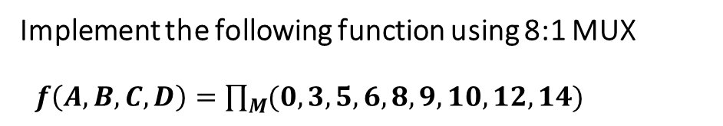
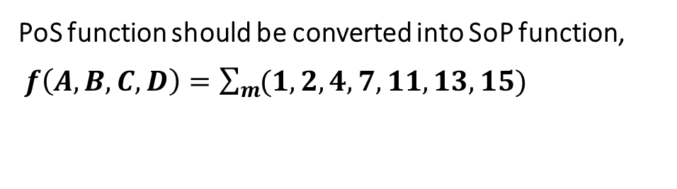
8:1 MUX
 | 0 | 1 | 2 | 3 | 4 | 5 | 6 | 7
 | 8 | 9 | 10 | 11 | 12 | 13 | 14 | 15
 | 0 |  |  | A |  | A | 0 | 1

Slide 13
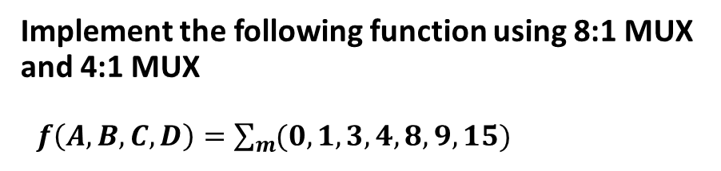
Using 8:1 Mux
8:1 MUX
 | 0 | 1 | 2 | 3 | 4 | 5 | 6 | 7
 | 8 | 9 | 10 | 11 | 12 | 13 | 14 | 15
 | 1 | 1 | 0 |  |  | 0 | 0 | A

Slide 14
















Using 4:1 Mux
4:1 MUX
 | 0 | 1 | 2 | 3 | 4 | 5 | 6 | 7
 | 8 | 9 | 10 | 11 | 12 | 13 | 14 | 15
 | 1 | 1 | 0 |  |  | 0 | 0 | A
B
C
D
C
D
4:1 MUX
C
D

Slide 15
Application of Multiplexer
It is used as a data selector to select one out of many data inputs.
It is used to implement combinational logic circuit.
It is used in time multiplexing systems.
It is used in ADC and DAC converter.
It is used in data acquisition systems.

Slide 16
THANK YOU…

Slide 17
ANY QUERIEES???…

